Slide 1
MASTER DATA MANAGEMENT (MDM)

Slide 2
INTRODUCTION
Bad data is bad for business. According to an Experian research report*, 89% of executives agree that inaccurate data is undermining their ability to provide an excellent customer experience.
An erroneous and incomplete data can hinder the process of decision making which can impact the growth of your business.
Now more than ever, business leaders all over the world have realized the importance of using high-quality information to drive business success. To meet these expectations, businesses turn to Master Data Management (MDM).

Slide 3
What is master data?
According to Gartner*, master data is the consistent and uniform set of identifiers and extended attributes that describes the core entities of the enterprise including customers, prospects, citizens, suppliers, sites, hierarchies and chart of accounts.
Let us simplify this for you.
You can think of master data as nouns that typically describe your business processes. For example, parties, products and locations are all master data domains. They are the core data assets that you manage within your enterprise.
The master data domains can be further divided into sub-domains. For instance, a party domain will have sub-domains such as customer, supplier, employee and salesperson.

Slide 4
Why do you need to manage master data?
Organizations continue to face issues with data as they grow. They spend a huge amount of resources to prepare data and gain insights. According to Experian’s 2018 global data management benchmark report*, 91% of executives believe that preparing data for insights ultimately costs their business in terms of resources and efficiency. All these resources go to waste if the prepared data is erroneous.
Similarly, there are other data related challenges which are the reasons that you should manage your master data. They are:
Inconsistent data across the value chain – Organizational data, in multiple versions, across functions, locations, and systems makes it difficult to ensure a single view of truth. This happens primarily due to the lack of an integrated approach to information management
Lack of cross-domain relationships – Domain masters (such as supplier, customer, product etc.) often lack the relationships among each other. This prevents business users from gaining operational intelligence making it difficult for organizations to manage interdependent business processes

Slide 5
3. Lack of process orchestration & data governance – Organizations struggle to maintain data integrity and security as they lack collaborative authorization of data. This makes it difficult for business users to manage and approve information in accordance with the organizational policies and processes
4. Authenticity of data manipulation – Maintaining and tracking logs for previous versions of data is often a challenge for the organization which can severely impact the authenticity of business processes

Slide 6
What is master data management?
Master Data Management (MDM) is the technology, tools and processes that coordinate your master data across the enterprise.
It provides a unified master data service to obtain an accurate, consistent and complete master data across the organization.
A master data management solution must have a Multi-Domain characteristic. The relationship between domains empowers business users to gain operational intelligence and improve decision making.

Slide 7
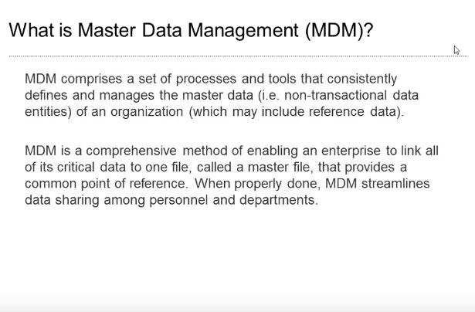

Slide 8
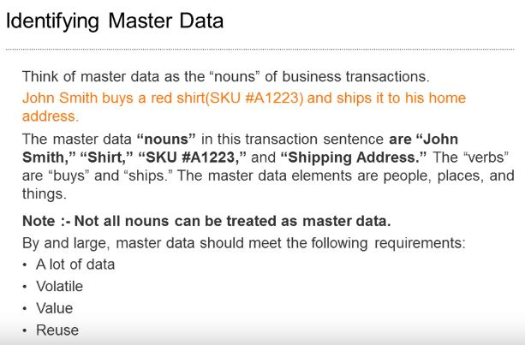

Slide 9
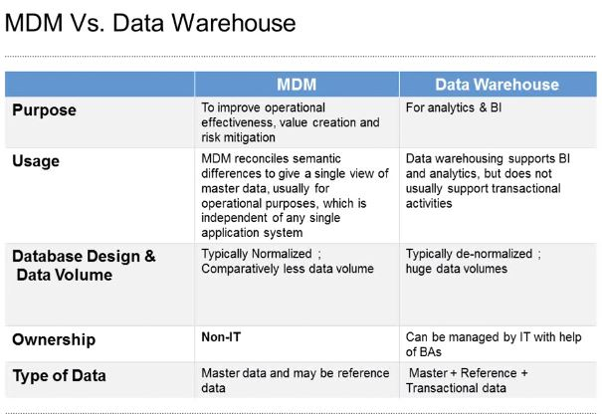

Slide 10
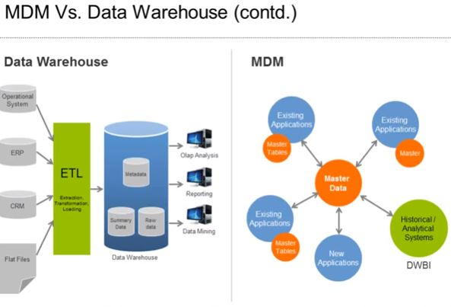

Slide 11
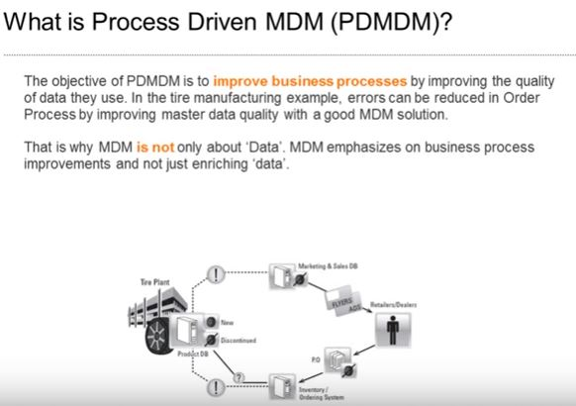

Slide 12
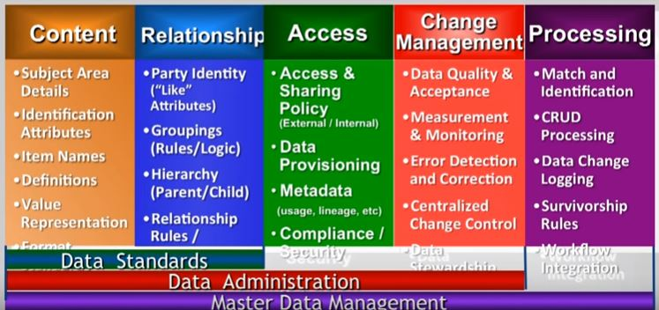
Key functions of an MDM system

Slide 13
Key functions & benefits of an MDM system
Provides seamless information across multiple channelsAccurate product data is critical to differentiate your business and provides customers with a dynamic and personalized shopping experience.
Product Information Management (PIM) helps businesses manage product data from multiple sources.
It creates a master catalog of validated, high-quality unique product data for efficient distribution to all sales channels, whether data is structured or unstructured.
Helps understand your customer better Customer data management helps organizations maintain a single view of all customer data. It synchronizes customer information across systems and the organization’s information supply chain.
Provides a unified view of your masters MDM software helps create reliable views to drive operations efficiently with a complete view of all your data assets.
It enables the creation of an integrated view of products, customers, suppliers, materials and other data sets. Currently, this data may reside in silos with different departments and units.
Increases trust in your data Poor quality data can have negative effects on customer relationships, business decision making, and forecasting. MDM system provides high-quality data for quality decision making.

Slide 14
Connects everything & anythingWith business information residing in multiple systems and in multiple formats, information users have to duplicate efforts by going through information from multiple systems and combining data together.
MDM’s data integration tool helps to combine data with multiple format attributes from disparate data sources. It delivers a single unified view of all your data instead of data in silos.
Increases accountability of your data: MDM’s master data governance feature can easily govern your organizational data for accuracy and accountability. Data governance brings business users in the implementation lifecycle and provides an effective mechanism to manage and author data.

